Slide 1
Air Quality Index
Guided By:-
Prof. Anmol Choudhary
Prepared BY:-
Rahul chouhan
Divyansh Lashkari
Shreyas Kshire
Sanskar Gupta

Slide 2
Introduction
The problem of air pollution has become a new challenge for the world. The air quality deteriorates throughout India in October and November months every year. The air quality is measured by the Air Quality Index. Let’s know what is the Air Quality Index (AQI) in India?

Slide 3
National Air Quality Index
India uses the National Air Quality Index (AQI), Canada uses the Air Quality Health Index, Singapore uses the Pollutant Standards Index and Malaysia uses the Air Pollution Index.

Slide 4
What is Air Quality Index
The National Air Quality Index (AQI) in India was launched on 17 September 2014 in New Delhi under the Swachh Bharat Abhiyan by the Environment Minister Shri PrakashJavadekar. The air quality index is composed of 8 pollutants ((PM10, PM2.5, NO2, SO2, CO, O3, NH3, and Pb).

Slide 5
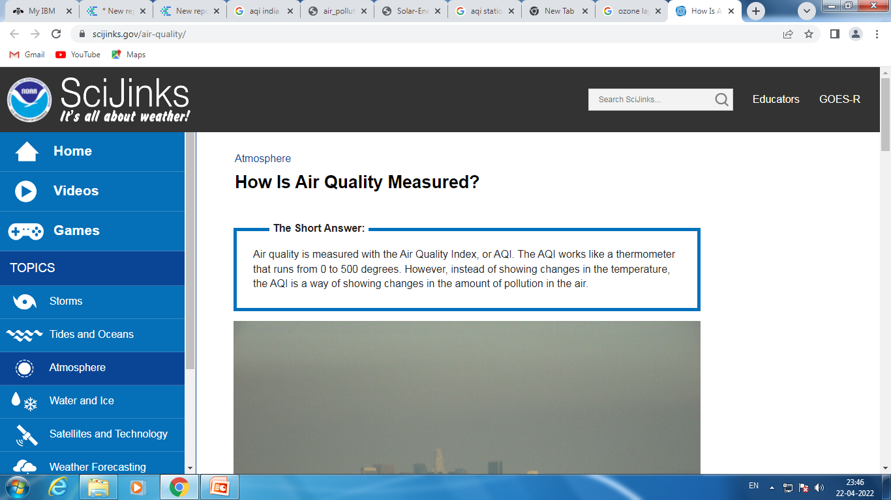

Slide 6
6 categories air quality index
The Air Quality Index measures the quality of air. It shows the amount and types of gases dissolved in the air. There are 6 categories of the air have been created in this air quality index.
These categories are based on air quality. These categories are;
good, satisfactory, moderate, poor, very poor and severe.

Slide 7
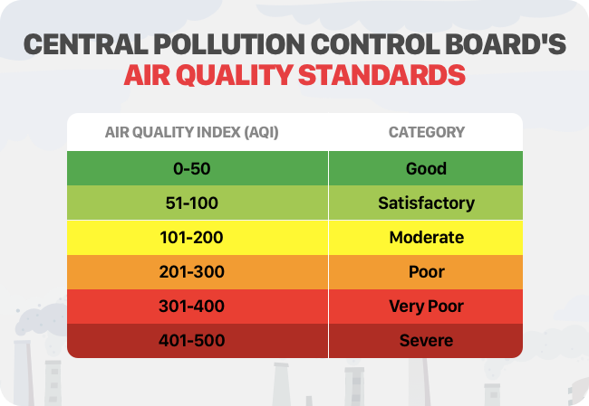

Slide 8
ibM cOGNOS
BM Cognos Business Intelligence is a web-based integrated business intelligence suite by IBM. It provides a toolset for reporting, analytics, scorecarding, and monitoring of events and metrics. The software consists of several components designed to meet the different information requirements in a company

Slide 9
Visualisation
the representation of an object, situation, or set of information as a chart or other image.
Data visualization helps to tell stories by curating data into a form easier to understand, highlighting the trends and outliers. A good visualization tells a story, removing the noise from data and highlighting the useful information

Slide 10
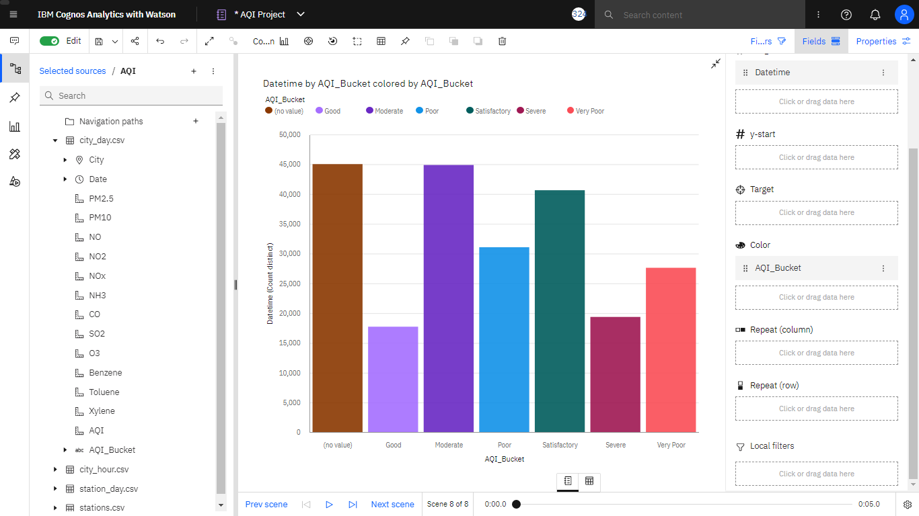
Air Quality Standards
Notes:
Here Column Visualization is Used; Coloring for differentiating AQ standers ; Filter includes NULL values

Slide 11
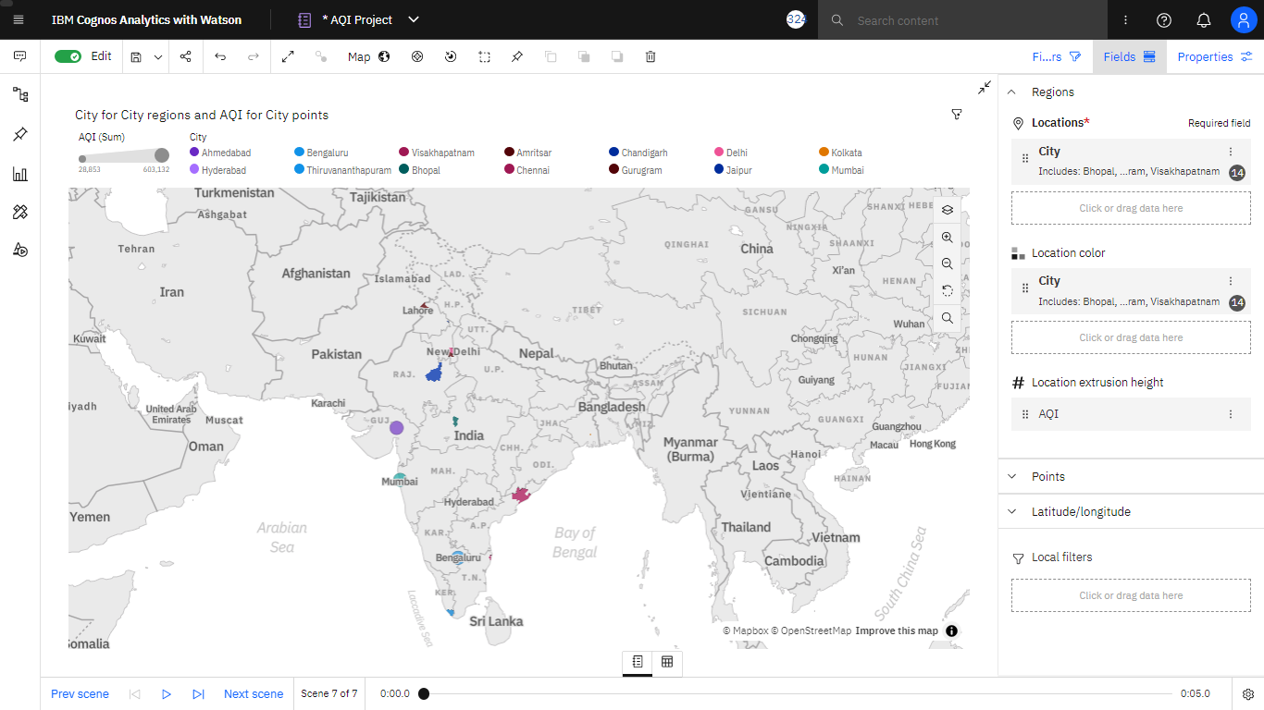

Slide 12
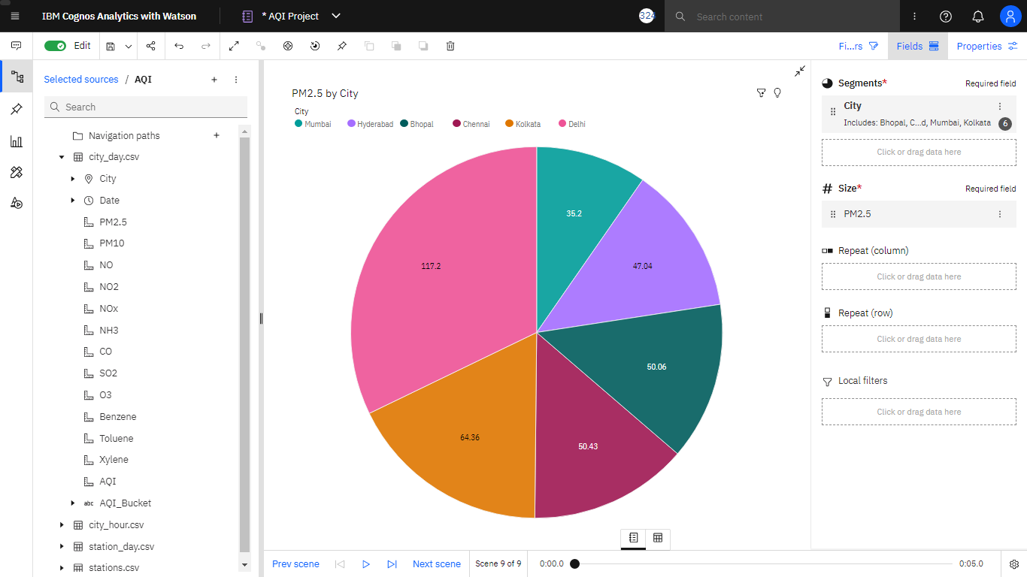
Notes:
Pie chart Visualization ; filter on City only selected cities are retrieved ; Summarization on PM 2.5

Slide 13
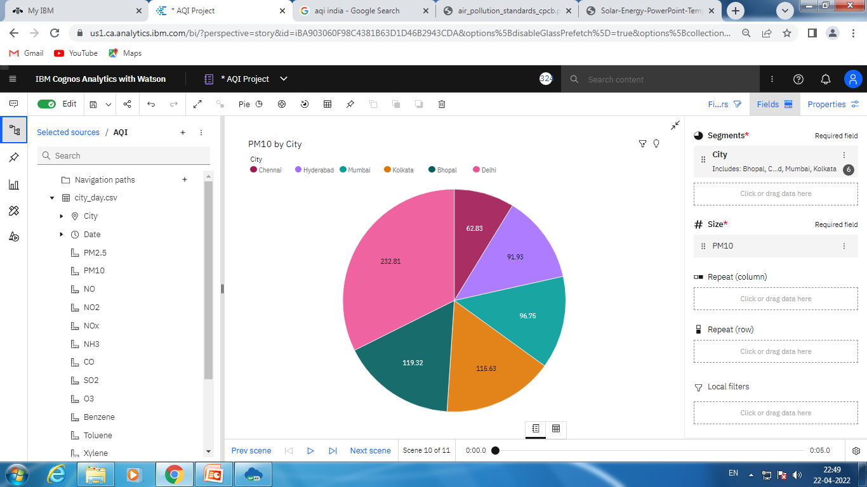

Slide 14
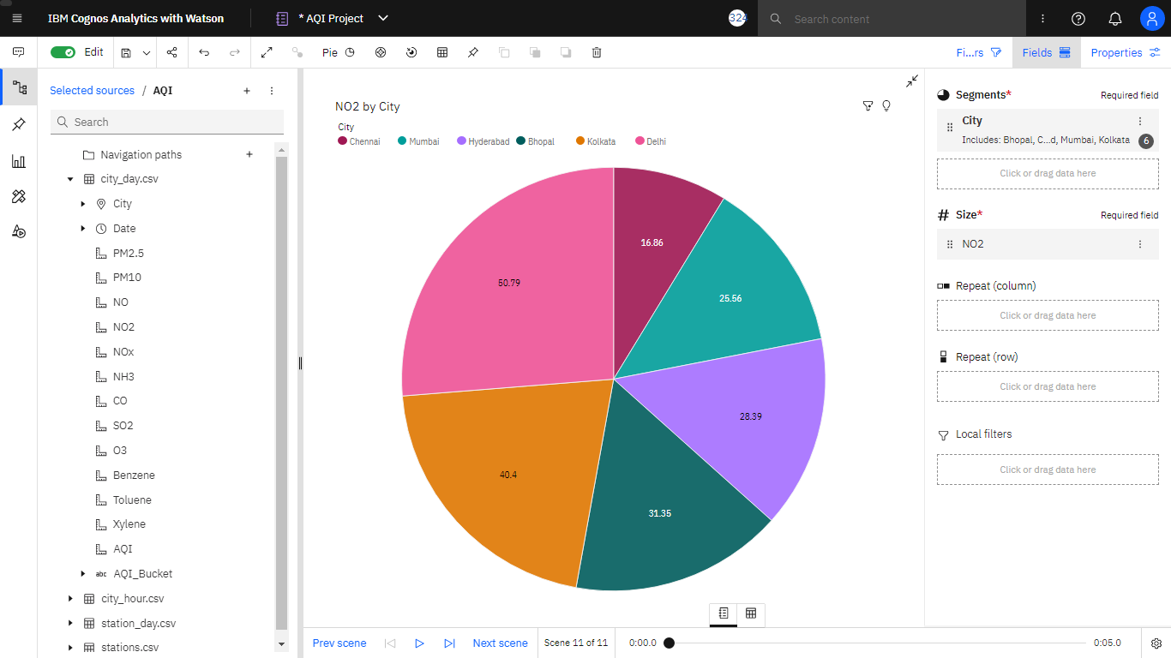

Slide 15
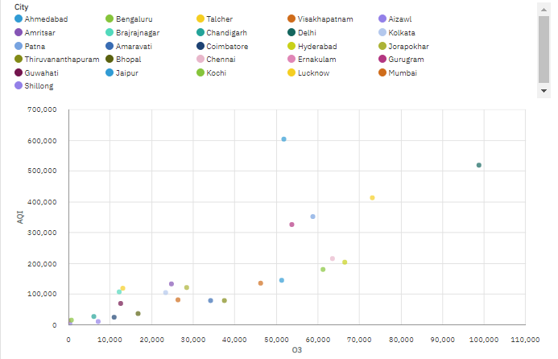
Ozone Concentration on ground

Slide 16
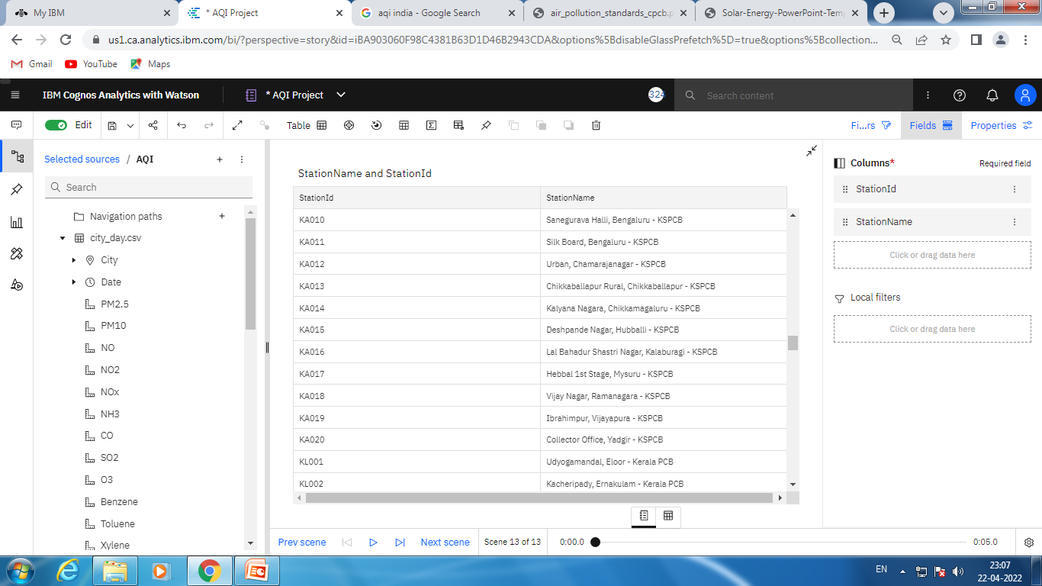
Notes:
Table Visualizations, filter only include active Stations

Slide 17
Reports
Reporting is a web-based report authoring tool that professional report authors and developers use to build sophisticated, multiple-page, multiple-query reports against multiple databases

Slide 18
Repost Using LIST Wizard
A list report that shows the data in rows and columns and each cell shows the data in the database or you can also add custom calculations in a list report.

Slide 19
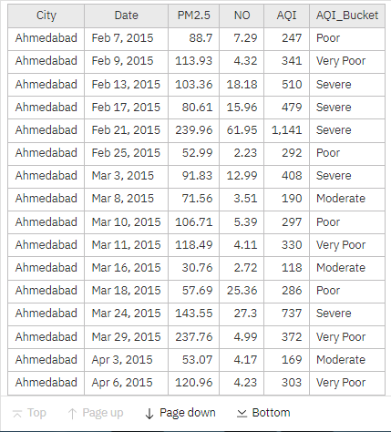
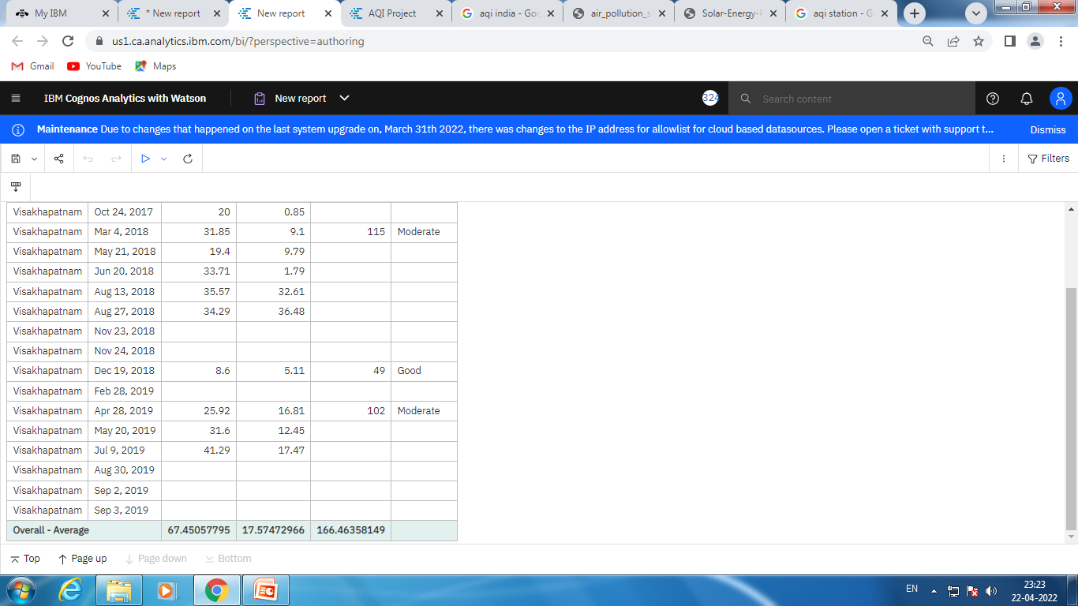
Daily Analysis of AQI

Slide 20
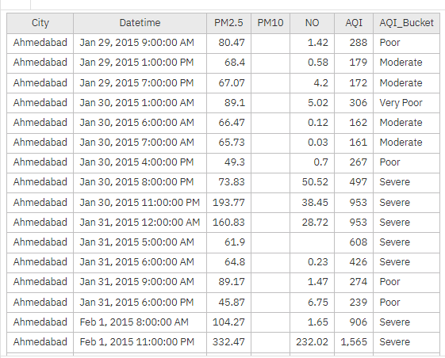
Hour wise Analysis of AQI

Slide 21
Cross tabs
Crosstab reports provide another perspective on the same data you see in the list report. It show information in a more compact form than in a grouped list. They are dimensional objects that have row edges and column edges. Each edge is composed of a set of crosstab nodes.

Slide 22
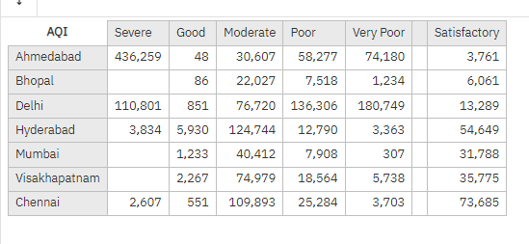
Report using cross tabs

Slide 23
Stories
A story is a type of view. A story is composed of a set of scenes that are displayed in sequence over time. Stories can be used to provide your data with a visual narrative.

Slide 24
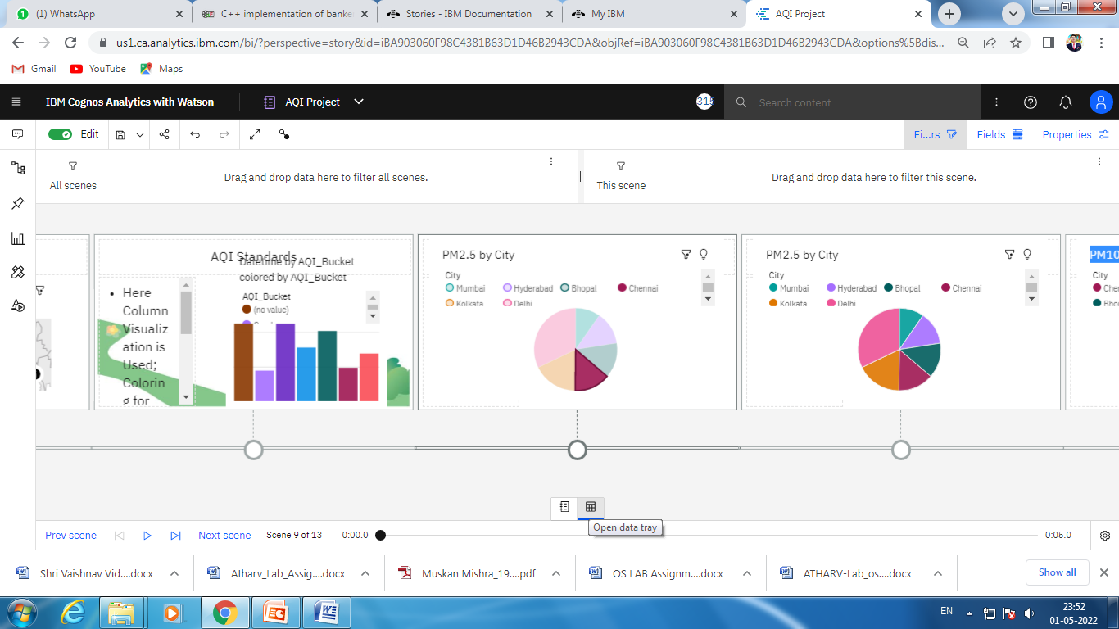

Slide 25
Conclusion
Air Quality Index in India : Beyond Danger Level
AQI :- 166.46
If there is increased awareness about Air Quality Index India and it’s health impacts depending on the various categories can help to reduce the incidence of air pollution to the most vulnerable people.

Slide 26
Thank You All

